Slide 1
Ambulatory Management
Unscheduled Radiology Orders

Slide 2

Agenda
  Project Overview
  Clean up
  Future State
    Dashboard
    Metric Measurement, Scheduling Workflow, Scheduling model
    Guiding principles
    High Level Project Timeline
  Resources
  Important System Updates
  Next steps

Slide 3
Project Overview
Problem Statement
There are ~160k unscheduled Radiology orders across MGB and 90k across MGH, which creates a significant quality and patient safety risk.
Goals/Metrics | Target | Status
Clean-up: Number of Unscheduled Radiology Orders within 3 months (August 2021) | Reduced by 50% | Achieved
Clean-up: Number of Unscheduled Radiology Orders within 6 months (November 2021) | Reduced by 100% | In-Progress
Future State: All orders are touched within 7 days | 100% | In-Progress
Root Cause
Orders themselves may not contain accurate or complete data to schedule from due to onerous order entry workflows
Ambulatory clinic Work queues not actively worked due to unclear expectations/accountability, inaccuracy/incorrect and/or volume of orders, or competing demand
  All scheduling by ambulatory clinic support staff
High Level Approach
Phase 1 – Clean-up of Backlog
Schedule, defer or cancel (as appropriate) existing Radiology unscheduled orders across MGH
Educate practices on best approach to clean up existing queues
Measure progress against resolution of backlog
Phase 2 – Develop Future State
Implement a standardized operating procedure across the system to prevent the re-accumulation of unscheduled orders
Ensuring new processes are sustained for future orders
Improve EPIC functionality to enhance future workflow model
Develop metrics to ensure accountability across organization

Slide 4
Clean Up Status
Overall, we have achieved (and surpassed!) the first MGB goal of 50% reduction by August 30th
Overall Progress – 62,854 orders (70%) reduced from baseline number
  Provider Progress – 14,158 orders (46%) of hand off number
  Scheduler Progress – 2,953 orders(21%) of reviewed orders
Practices (Physicians and APPs) must complete review of 100% of their orders by November 12th
AM team will continue to share progress and provide support and resources
Reach out to Liaisons team members for any questions or concerns
14,158 (46%) of orders handed to providers documented so far
62,854 (70%) orders reduced so far

Slide 5
Guiding Principles
Future State model requires review of all orders within 7 days guided by a clear process, set of actions, and best practices
Improved, standardized scheduling workflows to improve efficiency by centralizing the scheduling
All orders should be routed to ONE work queue regardless of the future state scheduling model
Own, monitor and update WQs
Dashboard to monitor and ensure timely execution of provider clinical intent with either Central or Local Scheduling Model
All departments with local or Central Scheduling Model must follow same guiding principles, actions to ensure consistency and efficiency
Improved Workflows
Monitor compliance
Efficient Workflow
One WQ

Slide 6
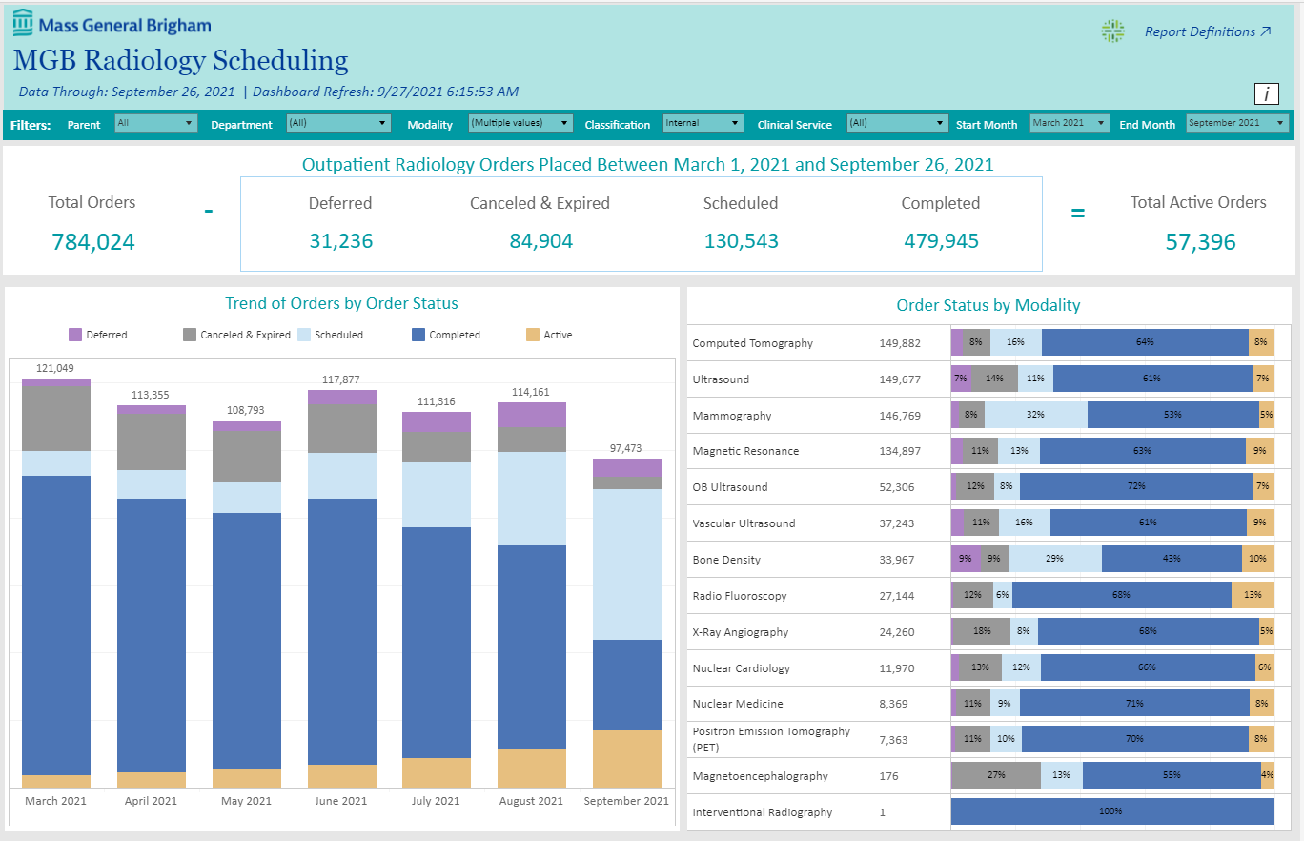
MGB Radiology Dashboard

Slide 8
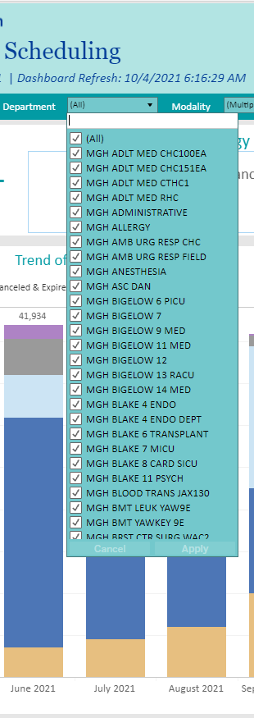
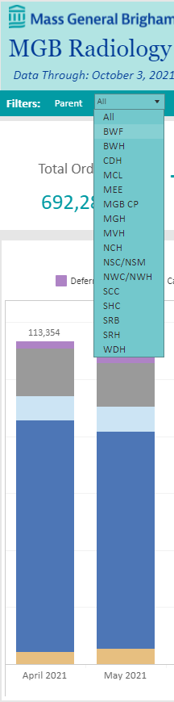
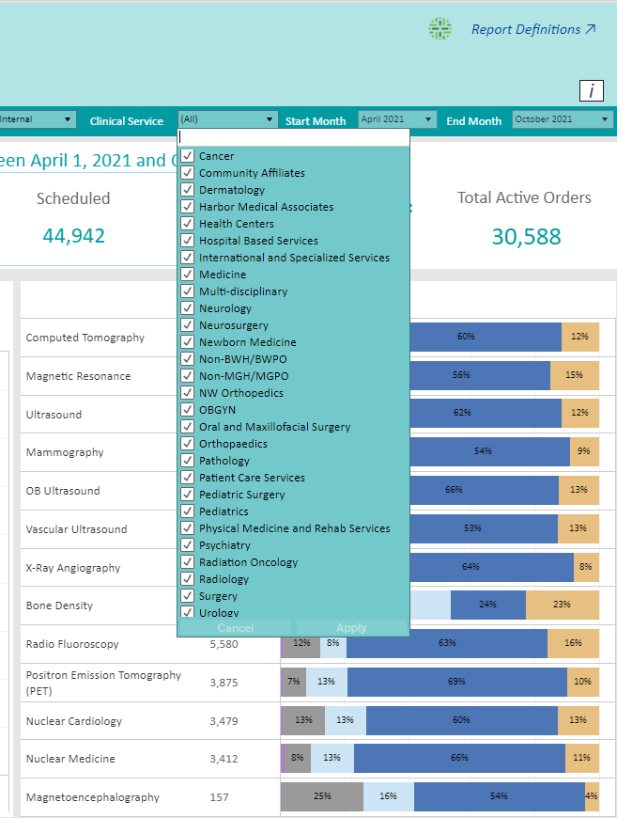
MGB Radiology Dashboard

Slide 9
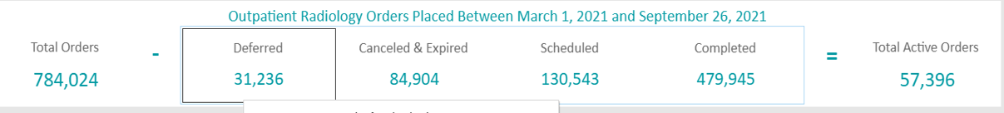
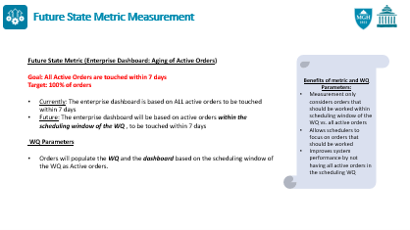
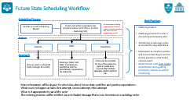
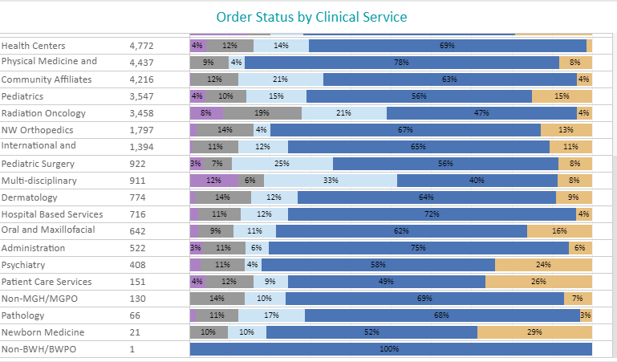
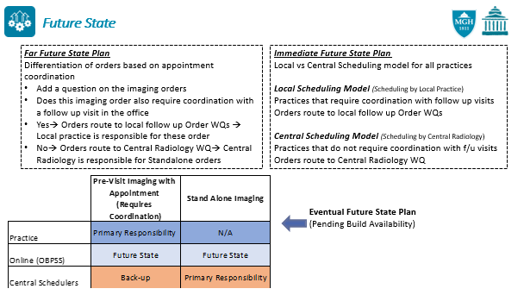
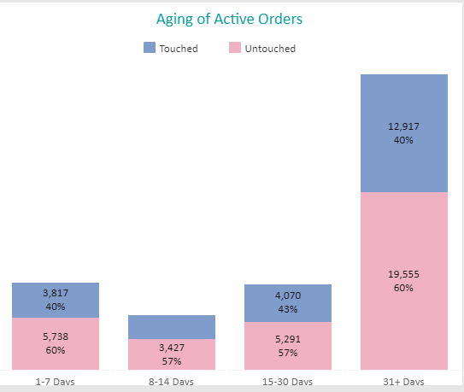
MGB Radiology Dashboard

Slide 10
Future State
Far Future State Plan
Differentiation of orders based on appointment coordination
Add a question on the imaging orders
Does this imaging order also require coordination with a follow up visit in the office
Yes→ ​Orders route to local follow up Order WQs → Local practice is responsible for these order
No→ Orders route to Central Radiology WQ→ Central Radiology is responsible for Standalone orders
Immediate Future State Plan
Local vs Central Scheduling model for all practices
Local Scheduling Model (Scheduling by Local Practice)
Practices that require coordination with follow up visits
Orders route to local follow up Order WQs
Central Scheduling Model (Scheduling by Central Radiology)
Practices that do not require coordination with f/u visits
Orders route to Central Radiology WQ
Eventual Future State Plan (Pending Build Availability)

Slide 11
Future State Metric Measurement
Future State Metric (Enterprise Dashboard: Aging of Active Orders)
Goal: All Active Orders are touched within 7 days
Target: 100% of orders
Currently: The enterprise dashboard is based on ALL active orders to be touched within 7 days
Future: The enterprise dashboard will be based on active orders within the scheduling window of the WQ , to be touched within 7 days
WQ Parameters
Orders will populate the WQ and the dashboard based on the scheduling window of the WQ as Active orders.
Benefits of metric and WQ Parameters:
Measurement only considers orders that should be worked within scheduling window of the WQ vs. all active orders
Allows schedulers to focus on orders that should be worked
Improves system performance by not having all active orders in the scheduling WQ

Slide 12
Future State Scheduling Workflow
Scheduling Process
Best Practices
Central or Local Scheduling Model
Orders will either populate local practice Follow order WQ or Central Radiology WQ
All the special handling orders will continue to route to special handling WQ as per current scheduling protocol
Notifying Patient
Notifying provider if order is discontinued following SOP
Scheduling a radiology order at checkout using Appt Desk
Dashboard to monitor Central and local scheduling to ensure timely execution of provider clinical intent
Departments with local model must follow same guiding principles, actions as central scheduling
Actions
Schedule
Defer
Discontinue
Approach
Once an order is scheduled it will no longer be on WQ
Entering a “Defer Until Date” is necessary to prompt the order to automatically move back to the Active tab
Orders can be cancelled for any of the reasons as patient unable to be reached after multiple attempts, patient declined etc.
More information will be shared for schedulers about future state workflow and practice expectations:
What needs to happen at failed first attempt, Second attempt, third attempt
When is it appropriate to cancel the order
The ordering provider will be notified via an In Basket message that a user discontinued a radiology order

Slide 13
Future State Scheduling Models
Central Scheduling Model
Local Scheduling Model
Adolescent Medicine
Anticoagulation
Burns Surgery
Charlestown Health Center
Chelsea Health Center
Dermatology
Interpreter Services
Laryngeal Surgery
North End Waterfront Health
Nutrition
Occupational Health Palliative care
Pathology
Pediatric Primary Care
Primary Care
PT/OT
Revere Health Center
Social Services
Speech, Language, Swallow
Weight Center
Anesthesia, Critical Care and Pain Medicine | Pediatric Specialty Care
Cancer Center | Pediatric Surgery
Cardiac Surgery | Pediatric Urology
Cardiology | Plastic and Reconstructive Surgery
Community Surgery | PM&R
Endocrine | Psychiatry
Gastroenterology | Pulmonary
General & GI Surgery | Radiation Oncology
Gynecology | Rheumatology, Immunology & Allergy
International and Specialized HCS | Surgical Oncology
Infectious Disease | Thoracic Surgery
Infertility and Reproductive Surgery | Transplant Surgery
Nephrology | Trauma Surgery
Neurology | Urology
Neurosurgery | Vascular Center
Obstetrics | Vascular Surgery
Oral and Maxillofacial Surgery | Wound Care
Orthopedics
** To see a detailed list of all DEPs with their future state scheduling model and the WQ for order routing, please use the link

Slide 14
High Level Project Timeline
August-September
Clean up process
FS Planning
Scheduling Models
October
Clean up by practices
Review FS scheduling models
Finalize project planning
Document and submit FS
Future State introduction
Future state training
Clean up process
November
October 4 and 5 Pulse calls to introduce FS
Finalize training materials
Clean up by practices
Finalize FS training
Finalize FS communication
Finalize Clean up process
December
Finalize clean up of existing orders by November 12
Complete final steps by November 30
Training to be completed by Nov 30
Socializing of FS guiding principles, expectations
Finalize Orders routing
FS Implementation and roll-out
Ongoing
Review WQ routing
Finalize FS WQ Routing
Finalize WQ testing
Go-Live for all practices on December 13
Current process review
Project progress review
Future State SOPs
Ongoing progress oversight
Follow Future State guiding principles
Ongoing Future Training
Radiology
AM
AMB. Practices
Leadership
Milestone

Slide 15

Future State Work Queue Implementation Timeline
The green box illustrates the month and week in which the future state work queues will go-live and every order will only live in one schedulable work queue and one catch-all work queue.
 | Go-Live Month and Week
Institutions | Oct |  |  | Nov |  |  |  |  | Dec
 | 11 | 18 | 25 | 1 | 8 | 15 | 22 | 29 | 6 | 13
NCH
MVH
NWH
CDH
SRH
MGBCP
MEE
MCL
WDH
NSM
BH*
MGH
Holiday Week
Current process review
Project progress review
Future State SOPs

Slide 16
Important Updates
All the practices are divided into either local or central scheduling model
Based on the model, all the imaging orders will route to one WQ
All the orders should be touched within 7 days
Orders will populate the WQ and Dashboard based on the WQ scheduling window
Expect dates are required on all imaging orders.
Future state scheduling workflow and responsibility will start on go live 12/13. Till that time, all the practices need to follow the current scheduling workflow and protocol
Ambulatory Blueprint website
  Linked here. Review the site for helpful resources, tip sheets, FAQs, pulse call slides
MGB Radiology Dashboard
Patient Letter Template
Expect vs Expired Date
Standard Smart phrases
Appointment Request Functionality
Key System Level Resources:
Dashboard Access: VPs, EDs and ADs

Slide 17
Next Steps/Training Plan
1. Clean Up by Practices:
  AM liaison team members will continue to share progress weekly for the clean up efforts of unscheduled radiology orders by practices
2. Training Plan
  HealthStream Training modules
    For providers
    General overview of the scheduling models, Expect vs expired date
    For Schedulers
    General overview of the scheduling models and practice expectations
    WQ management and scheduling workflow
  Important Dates
    October 22 – AM team will finalize training modules
    November 1 – Training material will be available to practices
    November 30 – Local practice schedulers to complete the training
3. Communication Plan:
  AM team will also continue to communicate, socialize the future state scheduling model and practice expectations during different meetings. Liaisons team members will provide resources and support.

Slide 18
Ambulatory Management
Unscheduled Radiology Orders

