Slide 1
Ambulatory Management
Unscheduled Radiology Orders

Slide 2

Agenda
  Project Overview
  Clean up
    Clean Up by Central Radiology
    Clean Up by Ordering Providers
    Pilot
  Resources
  Demo
  Next steps

Slide 3
Project Overview
Problem Statement
There are ~160k unscheduled Radiology orders across MGB and 90k across MGH, which creates a significant quality and patient safety risk.
Goals/Metrics | Target
Clean-up: Number of Unscheduled Radiology Orders within 3 months (August 2021) | Reduced by 50%
Clean-up: Number of Unscheduled Radiology Orders within 6 months (November 2021) | Reduced by 100%
Future State: All orders are touched within 7 days | 100%
Scope
In Scope:
Ambulatory Unscheduled Radiology Orders
BWH/BWFH, CDH, iCare, McL, MEE, MGBCP, MGH, MVH, NCH, NWH, Salem, SRH, SRB, SCC, SHC, WDH,
Out of Scope:
DFCI
Unscheduled orders outside of Radiology
Solution recommendations
1. Unscheduled Radiology Orders Clean-up
Schedule, defer or cancel (as appropriate) existing Radiology unscheduled orders across MGH
2. Enhanced Future State
In parallel with the “order clean-up”, implement a standardized operating procedure across the system to prevent the re-accumulation of unscheduled orders, ensuring new processes and expectations are sustained for future orders.

Slide 4





Solution recommendations - Benefits
Clinical intent of the provider is implemented in timely fashion​
Oversight and safety net provided with solution recommendations
No patient order is lost, and every order is brought to completion
Scheduling at the right time to guarantee experience is met
Radiology Orders WQ monitoring to follow up
Utilizing EPIC functionality to support the SOP workflow
Data reporting and sharing to measure and show progress
EPIC functionality to support the SOP workflow
Consistent and proactive approach to work on the radiology WQ will lead to more orders being completed
Patient Safety
Patient Experience
Practice workflow
Data Insights
Revenue Generation

Slide 5
High Level Project Timeline
April
Project Introduction
Project Planning
Data Validation
May - June
Plan AM recommendations
Project plan overview
Clean-up process Prep
Initial Clean-up
Plan Future State
July-August
Initial Clean-Up
VP Announcements​
Pulse calls​
AM Liaison meetings
Practice Communications​
Resourcing plan
Clean-up of existing orders
Finalize Future State
September-November
Clean-Up by Radiology
Share resources with Practices
Hand-off of remaining orders
Clean Up by Practices
Achieve 50% reduction by August 31​
Finalize Future State model
Project progress review
Complete clean-up
Implement Future State
Onwards
Achieve 100% reduction by November 30th​
Future state Model roll out and Implementation
Future State model best practices
Current process review
Project progress review
Future State SOPs
Ongoing progress review
Follow Future State guiding principles
Radiology
AM
AMB. Practices
Leadership

Slide 6
Clean Up
Clean-up by Central Radiology
      Central Radiology took the first pass for the cleanup efforts
      Started the cleanup process in early June and continued till late July
      Completed the process by reviewing the orders and taking appropriate actions; Cancel, Schedule or Escalate
      As they wrap up their review process, input will be needed from ordering providers
Cancel
Orders identified
1st level Reviewer
Schedule
Cancel
Escalate
2nd level Review
Schedule
Escalate
Hand Off
A Modality-based internal review led by Clinical Operations managers

Slide 7
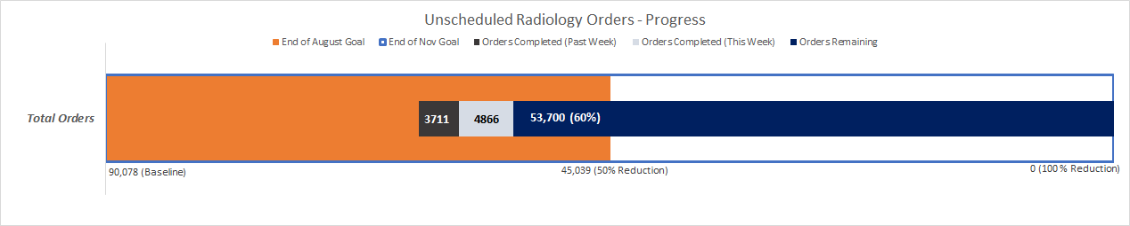
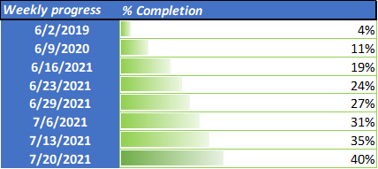
Clean Up – Current Status
Clean-up by Central Radiology
*Baseline – Unscheduled Radiology Orders
Orders placed on or before 5/6/2021
Order has an imaging order type
Orders are not expired
Filtered on outpatient
Included X-rays, vascular Ultrasounds, IR orders
*Central radiology clean-Up efforts
Started the cleanup process in late May-Early June
As of July 26th,
50% goal achieved for 25 Operational Cohorts
100% goal achieved for 5 Operational Cohorts

Slide 8
Clean Up
Clean-up by Ordering Providers
  Orders requiring clinical review will be handed off to the practices for ordering providers’ input
      Ordering providers will mark the order as: Discontinue, Schedule ASAP, Schedule Later
      Central Radiology will take the final steps based on the order status: Cancel, Schedule or Defer
  Hand-off of remaining unscheduled radiology orders will happen on July 30th
  After the hand-off, practices will be expected to complete the clean-up process and achieve MGB goal
    50% reduction by August 31st
    100% reduction by November 30th
Discontinue
Cancel
Hand Off
Ordering Provider
Schedule ASAP
Scheduler
Schedule
Schedule Later
Defer

Slide 9
Hand Off to Practices - Pilot
Completed hand off pilot to test documentation process
One provider from each operational cohort; Endocrine, Thoracic Surgery, Neurology.
Providers marked orders as: Discontinue, Schedule ASAP, Schedule later (specify month)
Central radiology for the final steps as: Discontinue, Schedule, Defer
Pilot practices/Pilot providers feedback included in preparing the final documents before sharing
Objective 1
Provide feedback on the overall process to make it better
Objective 2
Share feedback with other practices during pulse calls
Hand Off Pilot Objectives
July 12
July 13-July 15
July 16
July 19-July 23
July 23
July 26 & July 27
July 27-29
Introduced Pilot
Shared Documents
Received Feedback
Finalize Documents
Prepared Documents
Pilot
Share Feedback
July 30th - Share link to access documents and Hand off remaining unscheduled radiology Orders

Slide 10
Hand Off to Practices - Pilot Feedback
The team met with the pilot practices on the last day of the pilot, July 23rd. The feedback will be included in preparing the finalized spreadsheets for ordering provider's review. The feedback was about;
  Only include Data/Columns in spreadsheets, helpful to complete a review (Patient info, order info, DEP)
  Expected date information in the baseline data?
      Expected by date is not wholly accurate - only directionally accurate
      This field does not often indicate when a provider expects imaging to be completed - has often been pre-filled and favorited
  Define Ordering Provider action; Discontinue, Schedule ASAP or Schedule Later
      Discontinue – Order is no longer required
      If schedule ASAP – Need to happen within 30 days
      If schedule later – Need to happen after 30 days
"I found this exercise to be quite straightforward and I really did not encounter any issues in completing the pilot. I think this be will meaningful"

Slide 11
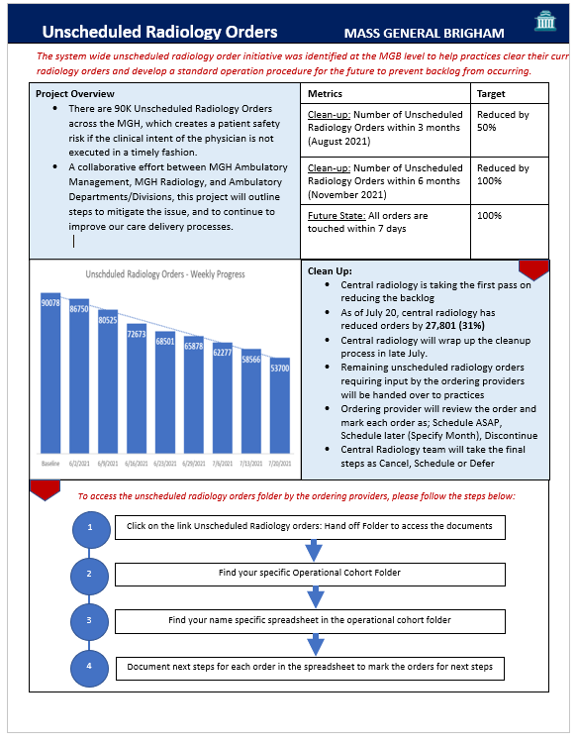
Resources
  To help and support practices during cleanup efforts, AM team has prepared the following resources:
  AM Blueprint Website
  Share Point Site
  One Pager
  Clinician Communication Email
  How to complete documentation - Tip sheet
Please share with the ordering providers to provide:
Project overview
Project Status
How to access orders

Slide 12
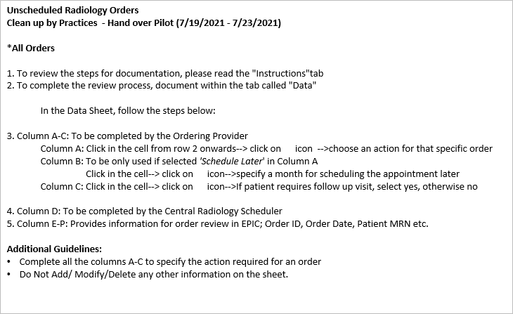
How to complete an order review
DEMO

Slide 13
Next Steps
Please review the information and share the project expectations and timeline with your team
To give an overview about the project, share the one pager with the ordering providers by end of day this Wednesday, July 28
A link will be provided to access documents for unscheduled radiology orders on July 30th.
    Note: The link will take you to the SharePoint site which will be updated after finalizing the provider spreadsheets
We will also send all the MGPO providers an email regarding the project update and steps to complete the review
Please make sure that ordering providers complete review and documentation of half of the orders by August 13th
Progress will be shared during the clean-up process by the AM team.

Slide 14
Questions

