Slide 1
Ambulatory Management and MGH Radiology
Unscheduled Radiology Orders
May 21 , 2021

Slide 2
Agenda
Project Overview
Project Structure
Solution Recommendations - Benefits
High level Project Timeline
Step 1: Clean-up of existing orders
Next Steps

Slide 3
Project Overview
Problem Statement
There are ~160k unscheduled Radiology orders across MGB and 90k across MGH, which creates a significant quality and patient safety risk.
Metrics | Target
Clean-up: Number of Unscheduled Radiology Orders within 3 months (August 2021) | Reduced by 50%
Clean-up: Number of Unscheduled Radiology Orders within 6 months (November 2021) | Reduced by 100%
Future State: All orders are touched within 7 days | 100%
Scope
In Scope:
Ambulatory Unscheduled Radiology Orders
BWH/BWFH, CDH, iCare, McL, MEE, MGBCP, MGH, MVH, NCH, NWH, Salem, SRH, SRB, SCC, SHC, WDH,
Out of Scope:
DFCI
Unscheduled orders outside of Radiology
Goals
1. Unscheduled Radiology Orders Clean-up
Schedule, defer or cancel (as appropriate) existing Radiology unscheduled orders across MGH
2. Enhanced Future State
In parallel with the “order clean-up”, implement a standardized operating procedure across the system to prevent the re-accumulation of unscheduled orders, ensuring new processes and expectations are sustained for future orders.

Slide 4
Project Overview
Problem Statement
There are ~160k unscheduled Radiology orders across MGB and 90k across MGH, which creates a significant quality and patient safety risk.
Metrics | Target
Clean-up: Number of Unscheduled Radiology Orders within 3 months (August 2021) | Reduced by 50%
Clean-up: Number of Unscheduled Radiology Orders within 6 months (November 2021) | Reduced by 100%
Future State: All orders are touched within 7 days | 100%
Scope
In Scope:
Ambulatory Unscheduled Radiology Orders
BWH/BWFH, CDH, iCare, McL, MEE, MGBCP, MGH, MVH, NCH, NWH, Salem, SRH, SRB, SCC, SHC, WDH,
Out of Scope:
DFCI
Unscheduled orders outside of Radiology
Goals
1. Unscheduled Radiology Orders Clean-up
Schedule, defer or cancel (as appropriate) existing Radiology unscheduled orders across MGH
2. Enhanced Future State
In parallel with the “order clean-up”, implement a standardized operating procedure across the system to prevent the re-accumulation of unscheduled orders, ensuring new processes and expectations are sustained for future orders.

Slide 5
Project Overview
Problem Statement
There are ~160k unscheduled Radiology orders across MGB and 90k across MGH, which creates a significant quality and patient safety risk.
Metrics | Target
Clean-up: Number of Unscheduled Radiology Orders within 3 months (August 2021) | Reduced by 50%
Clean-up: Number of Unscheduled Radiology Orders within 6 months (November 2021) | Reduced by 100%
Future State: All orders are touched within 7 days | 100%
Scope
In Scope:
Ambulatory Unscheduled Radiology Orders
BWH/BWFH, CDH, iCare, McL, MEE, MGBCP, MGH, MVH, NCH, NWH, Salem, SRH, SRB, SCC, SHC, WDH,
Out of Scope:
DFCI
Unscheduled orders outside of Radiology
Goals
1. Unscheduled Radiology Orders Clean-up
Schedule, defer or cancel (as appropriate) existing Radiology unscheduled orders across MGH
2. Enhanced Future State
In parallel with the “order clean-up”, implement a standardized operating procedure across the system to prevent the re-accumulation of unscheduled orders, ensuring new processes and expectations are sustained for future orders.

Slide 6
Project Overview
Problem Statement
There are ~160k unscheduled Radiology orders across MGB and 90k across MGH, which creates a significant quality and patient safety risk.
Metrics | Target
Clean-up: Number of Unscheduled Radiology Orders within 3 months (August 2021) | Reduced by 50%
Clean-up: Number of Unscheduled Radiology Orders within 6 months (November 2021) | Reduced by 100%
Future State: All orders are touched within 7 days | 100%
Scope
In Scope:
Ambulatory Unscheduled Radiology Orders
BWH/BWFH, CDH, iCare, McL, MEE, MGBCP, MGH, MVH, NCH, NWH, Salem, SRH, SRB, SCC, SHC, WDH,
Out of Scope:
DFCI
Unscheduled orders outside of Radiology
Goals
1. Unscheduled Radiology Orders Clean-up
Schedule, defer or cancel (as appropriate) existing Radiology unscheduled orders across MGH
2. Enhanced Future State
In parallel with the “order clean-up”, implement a standardized operating procedure across the system to prevent the re-accumulation of unscheduled orders, ensuring new processes and expectations are sustained for future orders.

Slide 7
MGB and MGH – Project Structure
MGB Executive Sponsor
Ron Walls, M.D.
Local Executive Sponsor:
Inga Lennes
MGB Steering Committee
MGB and Local Representation
Local Steering Committee:
Monthly Ambulatory Leadership Ops
Project Manager Status Update
MGB and Local Representation
Project Manager: Works closely with SMEs to execute on project plan, leads and plans agendas for Core Team & Steering Committee meetings
Local Project Manager: Lindsey Pabst/ Maddie Iqbal
Local Core Team / Process Owners: AM Liaisons and Dept/Division Leaders
MGB Project Management
Kate Bowles, Kelly Ross
MGB Project Lead
Niki Keefe
Local Subject Matter Expertise (SMEs): Adam Harbaugh, Karen Lean, Kristine Trites
Supports System-wide Steering Committee, Local Project Managers & Core Teams
MGB Core Team
Niki Keefe, Stuart Hooton, Adam Harbaugh, Kate Bowles, Kelly Ross
The project governance structure supports the clean-up effort of unscheduled radiology orders and the implementation of future state work queues to prevent re-accumulation of unscheduled orders.

Slide 8
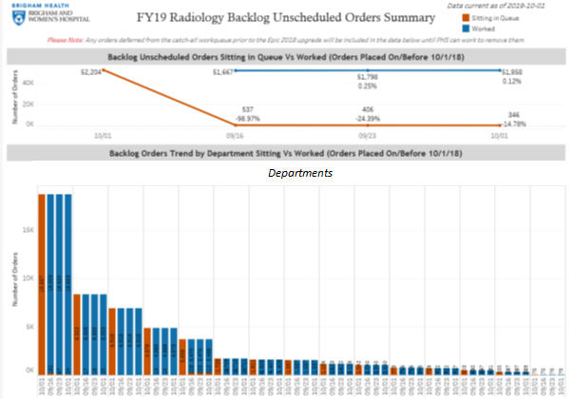
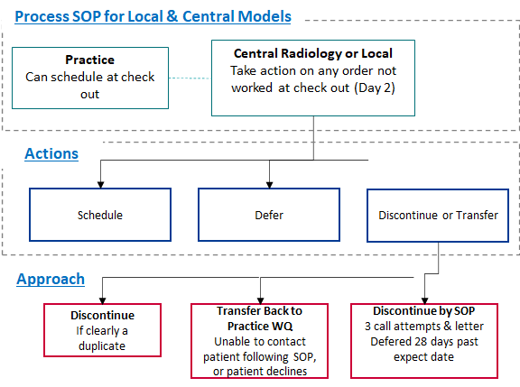
Brigham Experience
Brigham's Project Overview​
Over 50,000 unscheduled Radiology orders ​
Identified as a quality and patient safety risk ​
Radiology Orders Guiding Principles
​
All orders should only be routing to ONE WQ for the scheduling task.
Final Clean-Up​
~50,000 Radiology Orders to be scheduled reduced to 346 orders in under 6 months​
Weekly data transparency​
Organization-wide departmental Practice​
Local DEPs should know their individual WQ(s) and be actively monitoring and working on them.
Ambulatory Services owns and updates the Master List of Work Queue to DEP mapping.
All new DEPs will be set-up with consideration for routing of Radiology Orders.​
Best Practices
Notifying Patient
Notifying provider if order is discontinued following SOP
Dashboard to monitor Central and local scheduling to ensure timely execution of provider clinical intent
Departments with Local model must follow same guiding principles, actions and approach as Central scheduling
Regardless of Central or Local model the orders should be managed using same “best practice” principles.​​
If the DEP owner selects local scheduling model, the DEP will route to an existing or new Local Practice
If the DEP owner selects the Central scheduling model, the DEP will route order to Central Radiology
If no orders should be placed in the DEP, the DEP will also route to the Central Radiology WQ
Notes:
The project was initially introduced at Brigham when over 50,000 unscheduled Radiology orders were identified
These unscheduled radiology orders were identified as a quality and patient safety risk
Clean up of existing orders reduced the number to 346 orders in 6 months
This was completed in two steps, occurring at the same time; Clean-up efforts and future state development
Clean up was executed by clinicians & practice staff
Goal for future state; review of all orders within 7 days guided by a clear process, set of actions, and best practices

Slide 9

Solution Recommendations - Benefits
Clinical intent of the provider is implemented in a timely fashion​
Oversight and safety net provided with solution recommendations
Patient Safety

Slide 10

Solution Recommendations - Benefits
No patient order is lost, and every order is brought to completion
Scheduling at right time to guarantee experience is met
Patient Safety
Patient Experience
Practice workflow

Slide 11

Solution Recommendations - Benefits
Standard Operation practices for ordering and order management
Monitor and ensure accountability
Education on best practices for continuous improvement
Practice workflow

Slide 12

Solution Recommendations - Benefits
Data reporting and sharing to measure and show progress
EPIC functionality to support the SOP workflow
Data Insights

Slide 13

Solution Recommendations - Benefits
Consistent and proactive approach to work on the radiology WQ will lead to more orders being completed
Revenue Generation

Slide 14
Solution Recommendations - Benefits
Clinical intent of the provider is implemented in timely fashion​
Oversight and safety net provided with solution recommendations
No patient order is lost, and every order is brought to completion
Scheduling at the right time to guarantee experience is met
Radiology Orders WQ monitoring to follow up
Utilizing EPIC functionality to support the SOP workflow
Data reporting and sharing to measure and show progress
EPIC functionality to support the SOP workflow
Consistent and proactive approach to work on the radiology WQ will lead to more orders being completed
Patient Safety
Patient Experience
Practice workflow
Data Insights
Revenue Generation

Slide 15
High Level project Timeline
Step1: clean up
April
Project Introduction
Project Planning
Data Validation
May - June
Clean-up process Prep
Initial Clean-up
Plan Future State
July-August
Clean-up of existing orders
Finalize Future State
September-November
Project progress review
Complete clean-up
Implement Future State
Onwards
Current process review
Project progress review
Future State SOPs

Slide 16
High Level project Timeline
April
Project Introduction
Project Planning
Data Validation
May - June
Clean-up process Prep
Initial Clean-up
Plan Future State
Validate the data
Initial cleanup process plan
Finalize local project plan
July-August
Clean-up of existing orders
Finalize Future State
September-November
Project progress review
Complete clean-up
Implement Future State
Onwards
Current process review
Project progress review
Future State SOPs
Radiology
AM
AMB. Practices
Leadership

Slide 17
High Level project Timeline
April
April
Project Introduction
Project Planning
Data Validation
May - June
Clean-up process Prep
Initial Clean-up
Plan Future State
July-August
Clean-up of existing orders
Finalize Future State
Modality based internal review
Escalation of unresolvable orders
Preparation of remaining order lists hand off to AMB. practices
VP Announcements
Pulse calls
AM Liaison meetings
Review resources, tip sheets
Begin developing resourcing plan
September-November
Project progress review
Complete clean-up
Implement Future State
Onwards
Current process review
Project progress review
Future State SOPs
Radiology
AM
AMB. Practices
Leadership

Slide 18
High Level project Timeline
April
Project Introduction
Project Planning
Data Validation
May - June
Clean-up process Prep
Initial Clean-up
Plan Future State
July-August
Clean-up of existing orders
Finalize Future State
September-November
Project progress review
Complete clean-up
Implement Future State
Receive updated list of unscheduled orders by ordering providers
Project progress review
Achieve 50% reduction by August 31
Finalize Future State model and roll out plan
Onwards
Current process review
Project progress review
Future State SOPs
Radiology
AM
AMB. Practices
Leadership

Slide 19
High Level project Timeline
April
Project Introduction
Project Planning
Data Validation
May - June
Clean-up process Prep
Initial Clean-up
Plan Future State
July-August
Clean-up of existing orders
Finalize Future State
September-November
Project progress review
Complete clean-up
Implement Future State
Onwards
Current process review
Project progress review
Future State SOPs
Review timeline expectations
Review resources, tip sheets
Achieve 100% reduction by November 30th
Review and establish Future State model best practices
Radiology
AM
AMB. Practices
Leadership

Slide 20
High Level project Timeline
April
Project Introduction
Project Planning
Data Validation
May - June
Clean-up process Prep
Initial Clean-up
Plan Future State
July-August
Clean-up of existing orders
Finalize Future State
September-November
Project progress review
Complete clean-up
Implement Future State
Onwards
Current process review
Project progress review
Future State SOPs
Radiology
AM
AMB. Practices
Leadership
Ongoing progress review
WQ management to avoid backlog
Follow Future State guiding principles
Ongoing training for new staff

Slide 21
Next Steps
For Clean-up process; Radiology will complete the initial part of the process and reduce volume by removing the duplicates and identifying orders need to be cancelled
AM Liaison teams will reach out to ambulatory practices and identify current state, communicate best practices and complete clean-up process
For Future state Roll-out; More information will follow

Slide 22
Questions

