Slide 1
Procedure Pass, Procedural COVID-19 Tracking Dashboard, and COVID Testing Order Scheduling
Michael Cook
Training Lead
MGPO Business Transformation

Slide 2
What is Procedure Pass?
A tool for tracking and performing many of the tasks that need to be completed prior to a patient having surgery (e.g., COVID-19 testing prior to the procedure).
When a case request is submitted by an ordering provider practice, the case files into Procedure Pass.
Prior to 10/13/20
COVID testing scheduling was centrally managed by the Center for Ambulatory Services.
As of 10/13/20
COVID testing scheduling is handled by procedural areas by leveraging Procedure Pass.

Slide 3
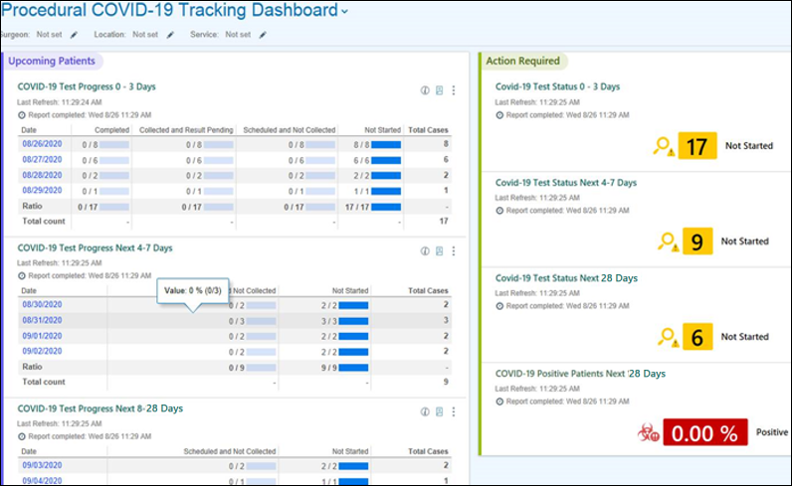
Procedural COVID-19 Tracking Dashboard
The Procedural COVID-19 Tracking Dashboard utilizes cases identified by Procedure Pass to track COVID testing progress. It shows an overview of the COVID testing statuses for patients with cases (OR and Endo only in current state) scheduled in the next 28 days by surgeon, location, or service.
At a high-level, site-based Procedural Scheduling teams can routinely review the Procedure Pass dashboard filtered by location and then order, schedule, and monitor COVID testing for all upcoming cases.

Slide 4
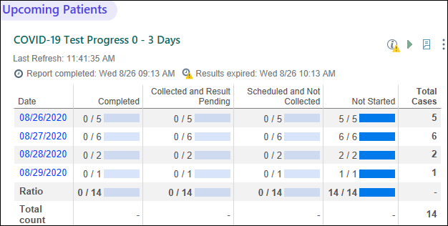
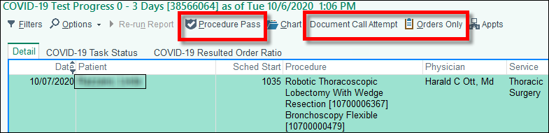
Procedural COVID-19 Tracking Dashboard Tools
Dashboard Tools:
Summaries by date for COVID test Ordering, Collection, and Resulting
Drilldown reports by date with filters to use as a work list for the Site-based Procedural Scheduling teams. Work list allows you to quickly access:
  Procedure Pass
  Orders Only encounters (for outpatient COVID testing ordering)
  Document Call Attempts to patients.

Slide 5
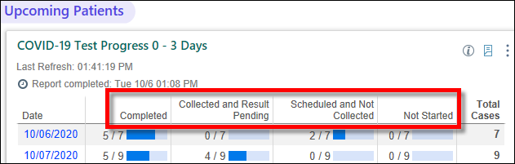
Dashboard Statuses
Status | Description
Completed | Patient completed COVID testing
Collected and Result Pending | COVID test sample collected, but not yet resulted
Scheduled and Not Collected | COVID test ordered, but date of test is a future date
Not Started | Order has not yet been placed. These patients need to be worked.

Slide 6
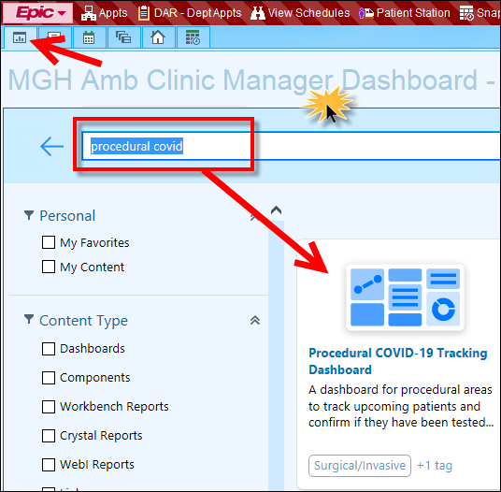
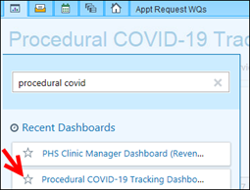
Accessing the Dashboard
From your My Dashboards tab, click the title of your dashboard.
In the search field, type “procedural covid” and then press Enter.
Click the Procedural COVID-19 Tracking Dashboard tile.
TIP: To easily access in future, click the dashboard title again and then click the star to make a favorite.

Slide 7
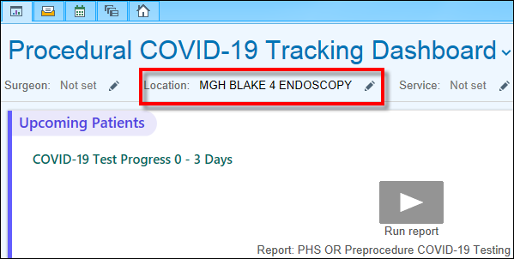

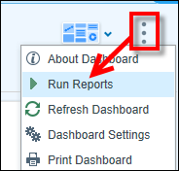
Running the Dashboard
Click the pencil to select the appropriate Location(s) you are covering.
TIP: You can also filter by Service in addition to Location if your area is a service level team. For example, Location: MGH OR; Service: Transplant surgery.
The dashboard buckets upcoming patients scheduled within the next 0-3 days, 4-7 days, and 8-28 days. To run all components on the dashboard at once, click the ellipsis on the top right corner of the dashboard and select Run Reports.

Slide 8
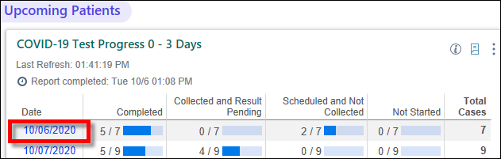
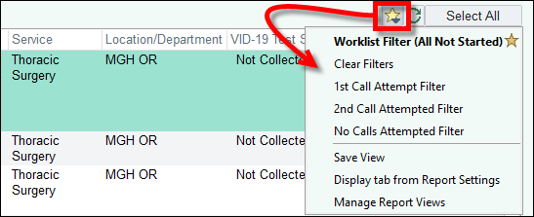
Accessing & Filtering the Work List
Click a date (blue link) to run a work list of patients.
Default filters are available on the work list via the star icon on the top right corner of the worklist.
Return to the original default filter.
View patients outside of the default filter.
Filter by call attempts made to patients (for 4-7 and 8-28 day reports).

Slide 9
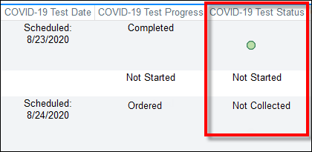
Work List: COVID-19 Test Status Column
COVID-19 Test Status column displays icons/text as an indicator of COVID-19 test status.
Icon/Text | Description | Action
 | Negative COVID test result | None
 | Positive COVID test result | Procedure area manages according to local guidelines regarding proceed w/ ERI or cancel procedure/OR
Inconclusive / Indeterminate | Inconclusive or Indeterminate test result | Procedure area manages according to local guidelines regarding proceed w/ ERI or cancel procedure/OR
Not Collected | Testing scheduled, but sample not yet collected | None
Collected | Collected test result, but waiting to be resulted | None
Not Started | Order has not yet been placed. | Place order for COVID testing

Slide 10
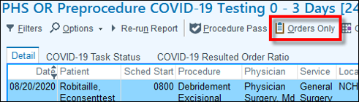
Contacting Patients (“Not Started” Status 4-28 Days Prior to Procedure)
Review the COVID-19 Test Status column for “Not Started” status.
Contact the patient using the phone number listed on the work list and schedule patient for COVID testing.
“Hello, this is <Name> calling from <Site>. Prior to your scheduled
procedure, you will need to be tested for COVID-19, can I schedule you now?”
Click Orders Only on the toolbar.
Click the Add Order field on the bottom of screen and search for “OP COVID-19.”
Select OP COVID-19 PCR LAB ORDER and then click Accept.

Slide 11
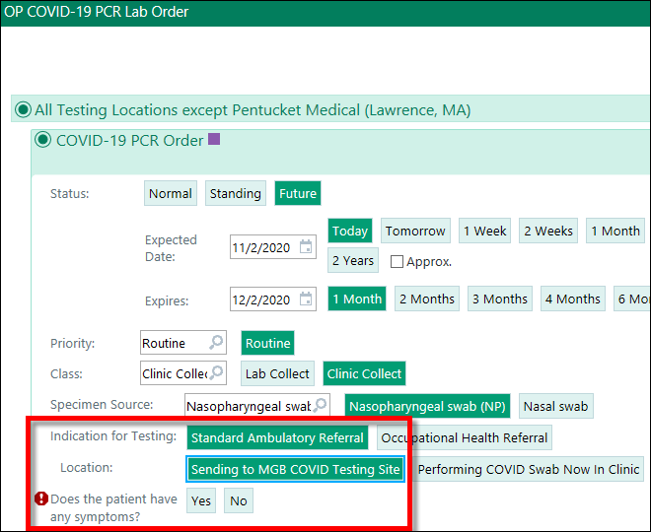
Contacting Patients (“Not Started” Status 4-28 Days Prior to Procedure), cont’d
Select All Testing Locations except Pentucket Medical (Lawrence, MA) or Pentucket Medical (Lawrence, MA) Testing Location, as appropriate.
In the Indication for Testing field, select Standard Ambulatory Referral.
In the Location for Testing field, select Sending to MGB COVID Testing Site.
Ask patient if they have any symptoms and answer any follow up questions required (red stop signs).
Enter the Date of the Procedure/Admission and then click Accept.

Slide 12
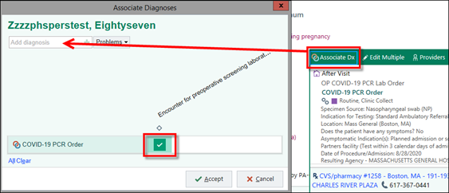
Contacting Patients (“Not Started” Status 4-28 Days Prior to Procedure), cont’d
Click Associate Dx from the order box on the bottom right of the screen.
Search for “Screening COVID” and select “Encounter for preoperative screening laboratory testing for COVID-19 virus.”
Click the checkbox to associate the order with the diagnosis.

Slide 13
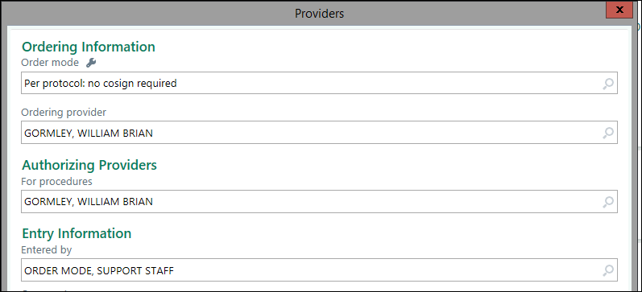
Contacting Patients (“Not Started” Status 4-28 Days Prior to Procedure), cont’d
Click Sign Orders.
In the Order mode field, select Per Protocol: no cosign required.
  Note: Both licensed clinicians and front desk staff can order with no co-sign required per MGB protocol.
In the Ordering provider field, type the name of the procedural physician. This name will automatically default in the For procedures field.
For non- clinical users, in the Entered by field, type “Support” and then select ORDER MODE, SUPPORT STAFF.
Click Sign Encounter.

Slide 14
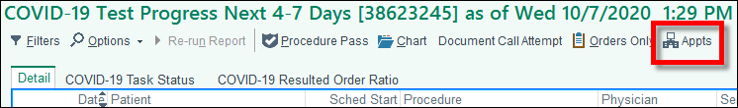
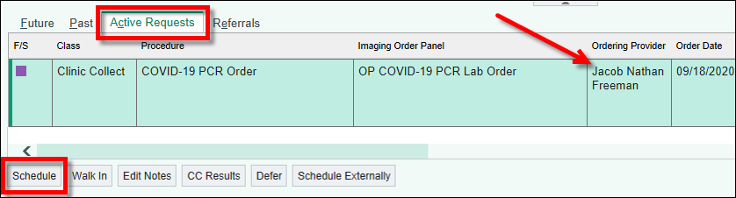
Scheduling COVID Testing Orders
Click Appts on the work list toolbar.
Click the Active Requests tab.
Select the COVID testing order and take note of the Ordering Provider. You may need this later for scheduling. Then, click Schedule or Order Up on the bottom toolbar.

Slide 15
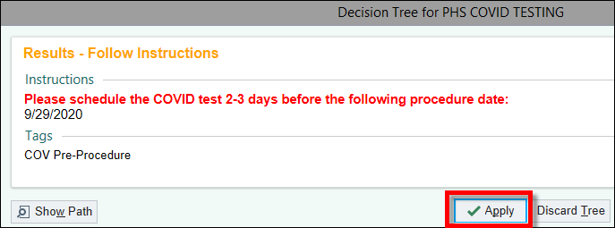
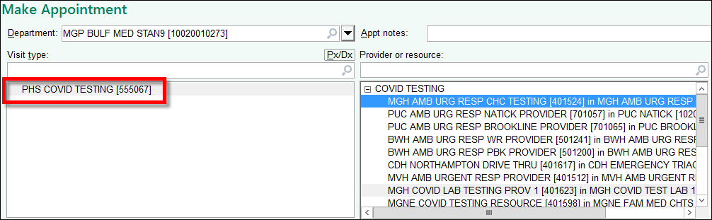
Scheduling COVID Testing, cont’d
For scheduling pre-procedure COVID testing, a Decision Tree window opens. Follow the instructions to schedule the testing 2-3 days before the date of procedure listed Click Apply
From the Make Appointment activity, enter any appropriate Appt Notes.
Leave PHS COVID TESTING [555067] in Visit type field. Do NOT remove/change this visit type.
Testing locations appear in the Provider or resource field. Say to the patient:
“We are offering COVID testing at various Mass General Brigham locations, some have more availability than others. Would you prefer the first available slot or rather a specific location?”

Slide 16
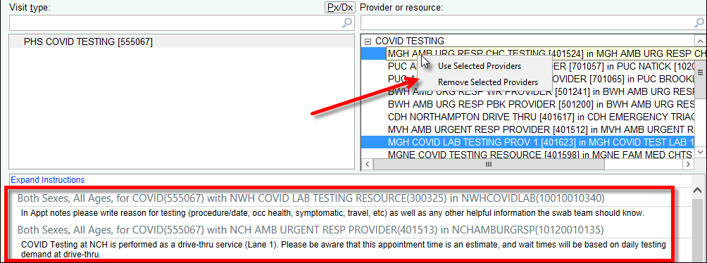
Scheduling COVID Testing, cont’d
If patient requests the first available appt at any location, leave all locations defaulted. To select a specific testing location based on the patient’s preference, right-click on the location and select Only Use This Provider.
  To select multiple locations, use Ctrl+click to multi-select locations, then right-click on one of the locations and select Use Selected Providers.
Review any scheduling instructions with the patient. Instructions are location-specific and it is important to communicate this information to patients.
Reminder:
Schedule the appt 2-3 days before the procedure date listed.

Slide 17
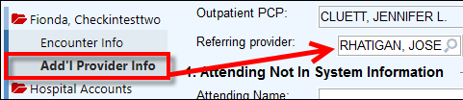
Scheduling COVID Testing, cont’d
Continue the normal scheduling process.
To complete the Registration activity, the Attending provider field in the Encounter Info form must be populated. If not defaulted, enter the ordering provider.
  You can also find the ordering provider by clicking the Add’l Provider Info form and view the Referring provider field.

Slide 18
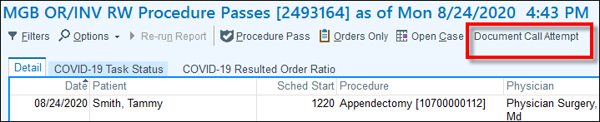
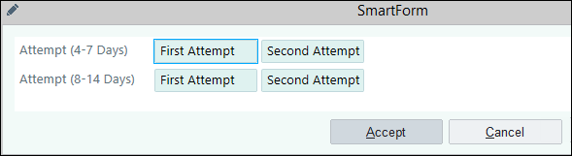

Contacting Patients (“Not Started” Status 4-28 Days Prior to Procedure) & Unable to Reach
Click Call Attempt on the toolbar.
Click the First Attempt or Second Attempt button, as appropriate.
Click Accept. Call attempts can be viewed via the ‘Call Attempt’ column on the work list.

Slide 19
Patients Without COVID Testing / Positive Test / Add On (≤ 3 days of Procedure)
If patient remains unscheduled, is COVID positive, and/or is an add on, the procedure area should manage according to local guidelines to get patient tested, make decision on PPE, or cancel procedure.
Run drill-down report from dashboard.
Filter/sort patients without COVID Testing, a positive test, or are an add on.
Review with department clinical leadership to determine next steps.
  Get patient tested
  Make decision on PPE
  Cancel procedure
Note: When surgical dates change, practices must cancel/reschedule the patient’s COVID testing.

Slide 20
Training & Support Resources
Training
Procedure Pass & Procedural COVID Tracking Dashboard Tip Sheet
Scheduling an Order for COVID Testing Tip Sheet
COVID-19 Testing Toolkit
Support
Break-fix issues, open a Help Desk ticket
For training-related questions, please email MGH eCare Training

Slide 21
Please chat in your Questions.

